Slide 1

Concurrency and Synchronization
Lecture-11
Parallel & Distributed Computing

Slide 2
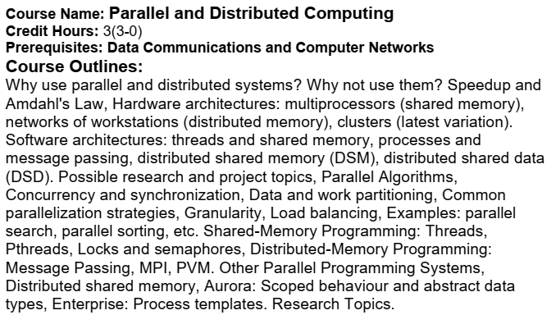
Course Outlines

Slide 3
Concurrency any Synchronization
Concurrency is the tendency for things to happen at the same time in any system.
Concurrency is when multiple tasks can run in overlapping periods.
It's an illusion of multiple tasks running in parallel because of a very fast switching by the CPU.
Two tasks can't run at the same time in a single-core CPU.
Parallelism is when tasks actually run in parallel in multiple CPUs.
In the real world, at any given time, many things are happening simultaneously.

Slide 4
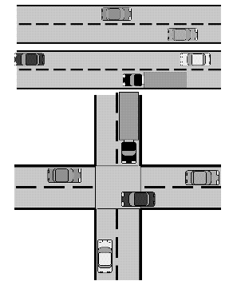
Concurrency any Synchronization cont…

Slide 5
Concurrency any Synchronization cont…
When dealing with concurrency issues in software systems, there are generally two aspects that are important:
Being able to detect and respond to external events occurring in a random order, and
Ensuring that these events are responded to in some minimum required interval.

Slide 6
Concurrency any Synchronization cont…
If each concurrent activity evolved independently, in a truly parallel fashion, this would be relatively simple:
We could simply create separate programs to deal with each activity.
The challenges of designing concurrent systems arise mostly because of the interactions which happen between concurrent activities.
When concurrent activities interact, some sort of coordination is required.

Slide 7
Concurrency any Synchronization cont…
Concurrency can be achieved by using multiple processors, cores, or threads, depending on the level of parallelism that you want to achieve.
Synchronization is the coordination of concurrent tasks, to ensure that they do not interfere with each other, or access shared resources in an inconsistent or unsafe way.

Slide 8
Concurrency any Synchronization cont…
The challenges of designing concurrent systems arise mostly because of the interactions which happen between concurrent activities.
Concurrency and synchronization can introduce potential risks, such as deadlocks, race conditions, starvation, or memory leaks.
When concurrent activities interact, some sort of coordination is required.
This coordination also called as Synchronization.
Notes:
In computer science, a memory leak is a type of resource leak that occurs when a computer program incorrectly manages memory allocations in a way that memory which is no longer needed is not released. A memory leak may also happen when an object is stored in memory but cannot be accessed by the running code.

Slide 9
Concurrency any Synchronization cont…
Basic synchronization primitives (atomic chunk of code):
Mutual exclusion: locks, mutexes, semaphores, monitors, …
Conditions: flags, condition variables, signals, …

Slide 10
Concurrency any Synchronization cont… Mutual Exclusion
Mutual exclusion is a property of concurrency control, which is introduced for the purpose of preventing race conditions.
It is the requirement that one thread of execution never enters a critical section while a concurrent thread of execution is already accessing critical section.

Slide 11
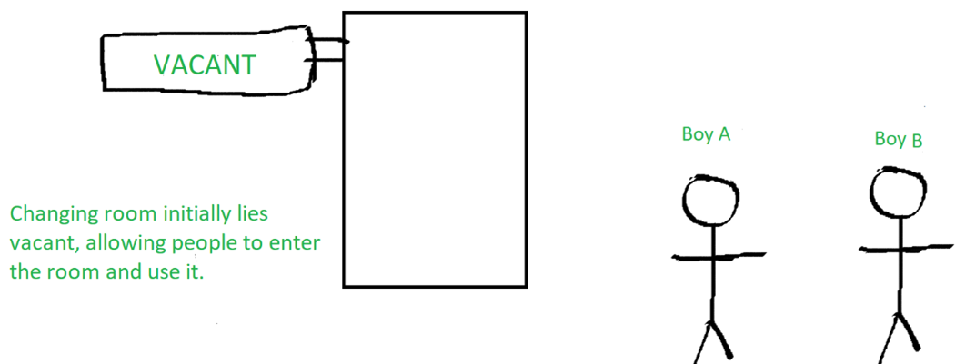
Concurrency any Synchronization cont… Mutual Exclusion

Slide 12
Concurrency any Synchronization cont… Mutual Exclusion (Race Condition)
Race condition is an undesirable event that can happen when multiple entities access or modify shared resources in a system.
The system behaves correctly when these entities use the shared resources as expected.
When race condition happens, the system may enter a state not designed for and hence fail.

Slide 13
Concurrency any Synchronization cont… Mutual Exclusion: Mutex
A lock or mutex (mutual exclusion) is a synchronization primitive: is a mechanism that enforces limits on accessing a resource when there are many threads of execution.
A shared resource in this context is a code element with a critical section, the part of the code that should not be executed by more than one thread at a time.
The first person to propose such primitive was Edsger Dijkstra, who suggested a new datatype called a semaphore.

Slide 14
Concurrency any Synchronization cont… Mutual Exclusion: Mutex (Semaphore)
A semaphore is an integer variable that supports an atomic test-and-set operation.
A semaphore is an integer variable used to control access to a common resource by multiple threads and avoid critical section problems.
A trivial semaphore is a variable that is changed (e.g., incremented or decremented) depending on conditions.

Slide 15
Concurrency any Synchronization cont… Mutual Exclusion: Mutex (Semaphore)
More specifically, if a S is a variable of type semaphore, then two atomic operations are supported on S: P(S) and V(S).
The letters P and V come from the Dutch words passeren, to pass (allow a resource to thread), and vrygeven, to release (released a resource by thread).

Slide 16
Concurrency any Synchronization cont… Mutual Exclusion: Mutex (Semaphore)
The operation P(S) achieves the following in an atomic manner:
if (S > 0)
decrement S;
else
wait for S to become positive;

Slide 17
Concurrency any Synchronization cont… Mutual Exclusion: Mutex (Semaphore)
The operation V(S) is defined as follows:
if (threads waiting for S)
assign one of them;
else
increment S;

Slide 18
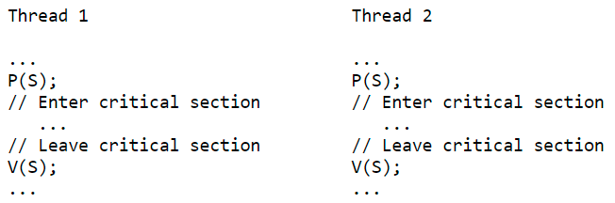
Concurrency any Synchronization cont… Mutual Exclusion: Mutex (Semaphore)
Using semaphores, we can now easily program mutual exclusion to critical sections, as follows:

